Slide 1
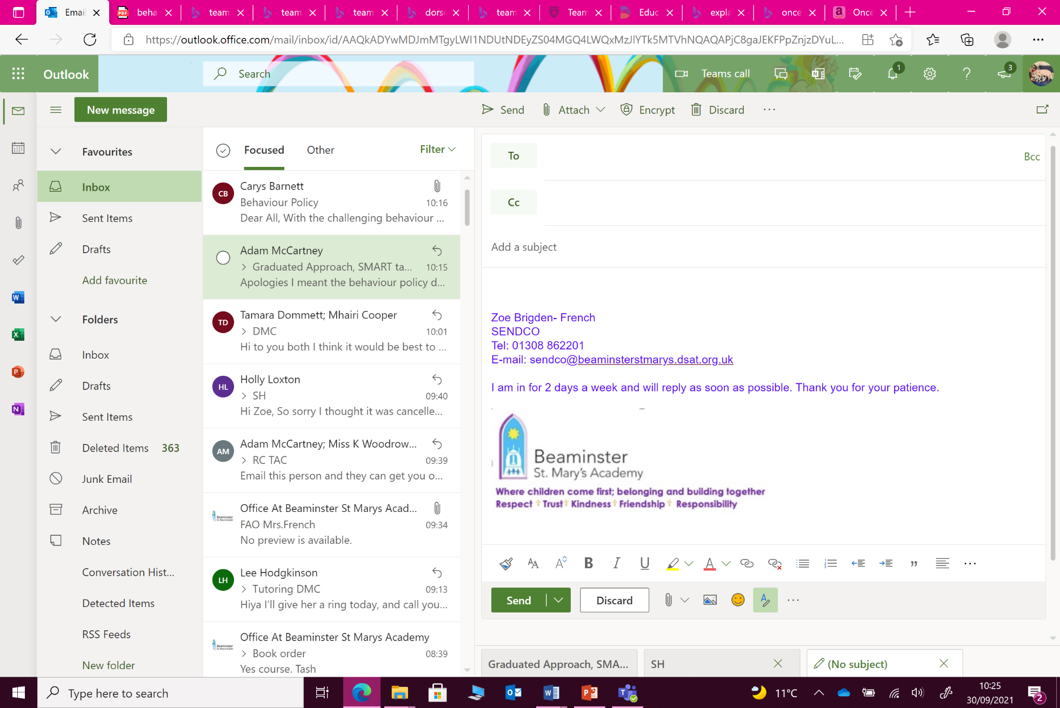
strategies to help you support your child’s literacy in the home
A bank of fun and easy ways to help you encourage your child to love reading and writing and support them in their literacy journey

Slide 2
Words are everywhere!
Help children to recognise the importance of literacy by showing them that letters and words are all around us.
Point out street names, posters, house plaques, road signs, shop titles etc.
Turn on the captions when watching TV so that children can link written words with spoken sounds.
Put books and other reading materials on show in the house and talk about them as much as possible.
Literacy is not just words: share drawing, singing, storytelling, acting, reciting, game playing and rhyming

Slide 3
Share the love of reading
Actively read with and listen to your child
Create a happy and cosy space when reading to or with your child. If the child enjoys being in the space, they will enjoy the reading. Vist a library if you can, to make choosing books and experience.
Take turns in reading the text with your child and point to words as you go
Show an active interest in what your child is reading or looking at by nodding, commenting and asking varied questions:
                Who do you like in the story?
                Where and when is this story set?
                What do you like about this page?
                Why do you think the character did that?
                What do you think might happen next?
Try to connect stories to things that your child already knows about and has interests in.

Slide 4
It’s ‘ok’ to make mistakes
Mistakes are an opportunity to learn and should be celebrated
Make mistakes yourself to show that not being right all the time is a part of learning
See if your child can notice and correct your errors.
Explicitly sound out words to show that reading doesn’t always come naturally.
          You make want to look at this guide as to how your child is supported with phonics in school: Parent guide to Read Write Inc. Phonics | Oxford Owl
Give the child time and gentle encouragement if they are struggling.

Slide 5
Reading and writing isn’t just in books
Use any opportunity to encourage reading and writing
Shopping lists
Role play (e.g. doctors surgery, vets practice, restaurant, kitchen etc)
Rules for games
Label objects around the home
TV subtitles / captions
Letters and cards

Slide 6
Comprehension is key
For your child to get the most out of reading and writing, they will need support to understand texts
Ask them questions and encourage them to ask you questions.
Point of new words and talk about them: what other words does it look / sound like? What does it mean? What other words have the same meaning? Where might you see it again?
Try to use a range of words when you are talking to your children. Maybe set yourself a goal to use a new word each week!

Slide 7
Have fun!
Make reading and writing a shared, fun, and stress- free experience. There are so many games that you can play in the care, whilst out walking, at the dinner table, on the way to school…
See the following slides for age and progress related game ideas that range from Eye Spy to Consequences and lots in between.

Slide 8
Words games for pre- readers and writers
Animal sounds
I spy
Colour / shape / picture matching
Letter or not letter?
Words for Life | National Literacy Trust | Words for Life

Slide 9
Words games for early readers and writers
23 Fun Reading Games for Kids | Brightly (readbrightly.com)
8 literacy games for kids that will encourage them to read | NewFolks
Pre-Reading Activity and Game Printables (dogonalogbooks.com)
Words for Life | National Literacy Trust | Words for Life

Slide 10
Words games for progressing readers and writers
List of 50 Great Word Games for Kids and Adults (dailywritingtips.com)
18 Quick, Creative Activities to Boost Reading and Writing in KS1 and KS2 (teachwire.net)
Words for Life | National Literacy Trust | Words for Life

Slide 11
And finally…
Talk!
Talking with, to and in front of your child is the best thing you can do on a day to day basis to support their literacy.
Studies show that it is very important that developing children be immersed in a language rich environment.
To summarise:
Children who are spoken to and read to are more likely to want to speak and learn to read and write. Children who are more likely to want to speak and learn to read and write are more likely to develop reading and writing skills.

